Slide 1
Lecture 4: Exploratory Data Analysis
Intro to Data Science for Public Policy
Jeff Chen

Slide 2
Roadmap
Homework Review
EDA
Code-along
Intro to Data Science for Public Policy

Slide 3
Roadmap
Homework Review
EDA
Code-along
Intro to Data Science for Public Policy

Slide 4
Two rationale for the homework:
Replication based on instructions
Science is only credible if it can be reproduced
Implement among the most common programming paradigms
Programming paradigms are often absent among new data scientists
Homework
Notes:
Goal is to break you free from thinking exclusively in terms of regression models

Slide 5
Roadmap
Homework Review
EDA
Code-along
Intro to Data Science for Public Policy

Slide 6
“Exploratory Data Analysis is really the process of understanding how you react to data. It is not about the graphs and statistics, but a matter of defining your quantitative identity and process.”
- Star Ying
Bayesian Statistician
Motivation

Slide 7
Concretely, your quantitative identity is a function of how you deal with separability, correlation, and usability. Understanding your biases and propensity to treat the data in a certain way is also part of that identity.
Motivation
Notes:
Goal is to break you free from thinking exclusively in terms of regression models

Slide 8
There is no way to understand EDA than to conduct it 10+ times in the wild.
Motivation
Notes:
Goal is to break you free from thinking exclusively in terms of regression models

Slide 9
Dimension | Star Ying | Jeff Chen
Statistical School | Bayesian | Frequentist
First thing I do with text data | “What? What is the problem I’m trying to do? | I check to see if the target variable is available. Then, I read the first 5 lines, then proceed to write a vectorize function to parse words by spaces so that I can find most common terms.
First thing I do with numeric data |  | I check to see if the numeric is numeric, then run a kernel density graph by group and a Kolmogorov-Smirnov test
Motivation

Slide 10
Usability
Conversion of raw data into model-enabled information
Converting between data formats
Understanding missingness of data points
Extracting signal from raw data
Motivation

Slide 11
Usability
Extracting signal from raw data
=
+
Motivation

Slide 12
Separability
The extent to which two or more groups can be distinguished using one or more features
Idea: if you can see the differences with your eyes, there should be a mathematical solution.
Motivation

Slide 13
Visual Separability
Graph that shows clear differences in clustering.
Motivation

Slide 14
Statistical Separability
Continuous
T-test//Z-test
Kolmogorov-Smirnov Test
Discrete
Chi-squared
Confusion Matrix
Motivation

Slide 15
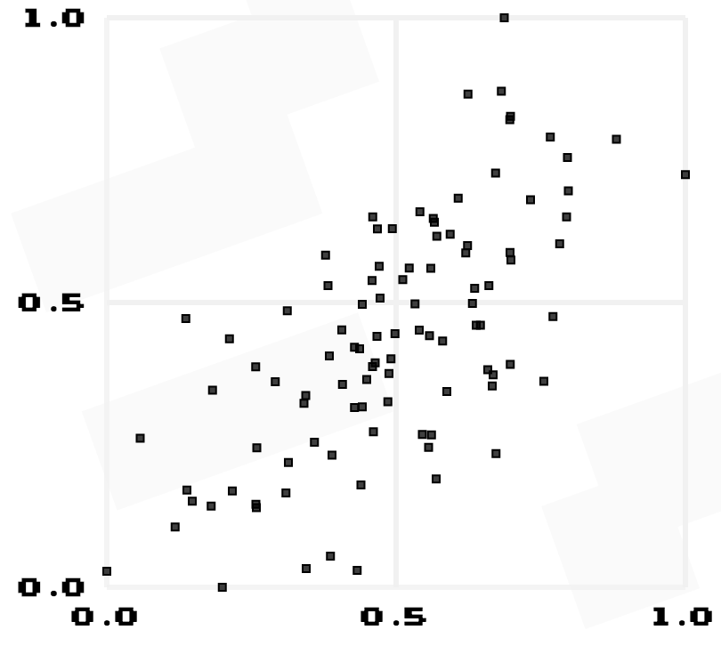
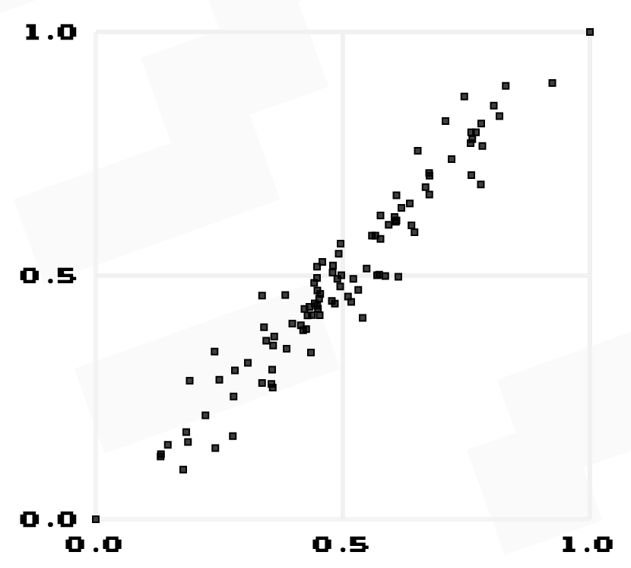
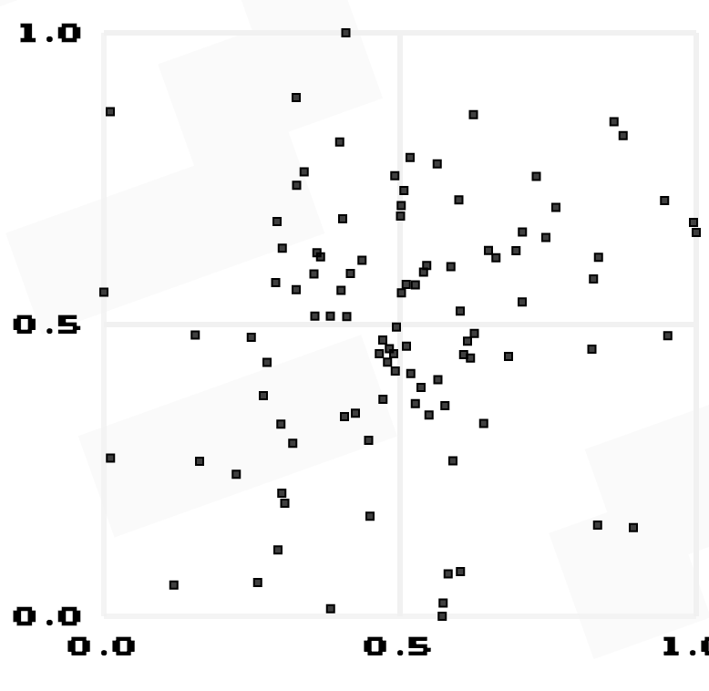
Correlation
The extent to which two or more quantities are related or connected.
Motivation

Slide 16
Statistical Correlation
Continuous
Pearson’s Correlation Coefficient
Cosine Similarity
Discrete
Cosine Similarity
Jaccard Similarity
Motivation

Slide 17
Visual Correlation (Continuous)
guessthecorrelation.com
Use scatter plots, train your eyes on:
Motivation
Notes:
Goal is to break you free from thinking exclusively in terms of regression models

Slide 18
A Framework for EDA
Area | Goal | Common Questions
Usable | Assess the data types | Are the data categorical, numerical, factor, strings, other? What manipulations will you need to perform to get the data into usable shape?
Separable, Correlated | Understand the empirical distributions | Does the data fall into a commonly recognized shape? Is it unimodal, bimodal? Is there any indication of time-dependence?
Usable | Detect outliers, missingness and errors | Are there anomalous values? - Do records spike or occur during odd times? - How complete is the data? - Which variables need to be standardized and cleaned?
Usable | Check the assumptions | How exactly is the data collected? Does the data reflect what would be expected?
Correlated | Identify important variables | Which variables are correlated with one another?

Slide 19
Example
Smartphones have accelerometers that can measure an user’s motion. Accelerometers are the basis of activity tracking devices.
Motivation

Slide 20
Example
Goal is to understand how we can use acceleration readings to characterize physical activity.
Motivation

Slide 21
Pre-Work: Assess
Goal | Common Questions
Assess the data types | Are the data categorical, numerical, factor, strings, other? What manipulations will you need to perform to get the data into usable shape?
Convert all variables into the right format
Reshape data (transform to wide form)
Filter out noise and/or transform data into derivative form
Motivation

Slide 22
Assess Raw Dataset
Convert data from long form to analyzable wide form
Time | Type | Value
1 | Accel.X | 0.068
1 | Accel.Y | 0.357
1 | Accel.Z | 0.673
1 | Label | Walk
2 | Accel.X | 0.403
2 | Accel.Y | 0.476
2 | Accel.Z | 0.359
2 | Label | Walk
Motivation

Slide 23
Assess Raw Dataset
Convert columns
Time = as.Date()
Accel.X = num
Label = as.character()
Time | Accel.X | Accel.Y | Accel.Z | Label
1 | 0.068 | 0.357 | 0.673 | Walk
2 | 0.403 | 0.476 | 0.359 | Walk
3 | 0.683 | 0.298 | 0.186 | Walk
4 | 0.505 | 0.054 | 0.753 | Walk
5 | 0.264 | 0.662 | 0.240 | Walk
6 | 0.021 | 0.044 | 0.017 | Stand
7 | 0.024 | 0.011 | 0.001 | Stand
8 | 0.003 | 0.019 | 0.042 | Stand
Motivation

Slide 24
#2 -- visualize
Goal | Common Questions
Understand the empirical distributions | Does the data fall into a commonly recognized shape? Is it unimodal, bimodal? Is there any indication of time-dependence?
#How JC approaches a time series: Goal – distill signal
##check structure for NAs
####Graph data as line graph and kernel density
####If multiple related variables
######Combine into an index to reduce dimensionality
##Graph the kernel densities globally and by group
Motivation

Slide 25
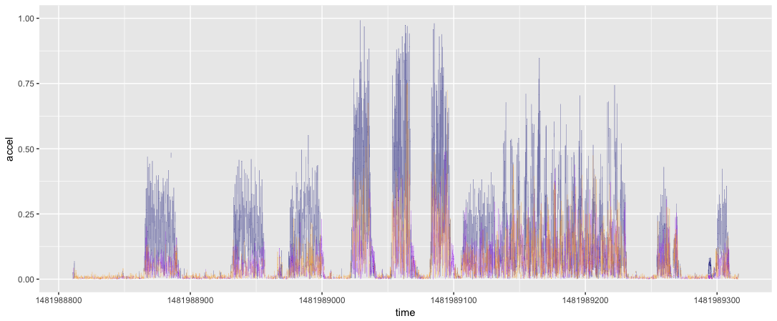
Three-Series Graph of Raw (20 hertz)
Motivation

Slide 26
Three-Series Graph of Raw (20 hertz)
Motivation

Slide 27
Log10(Raw)
Motivation

Slide 28

Net Accel
Accel$=\sqrt{x^{2}+y^{2}+z^{2}}$
Time | Accel.X | Accel.Y | Accel.Z | Label | Net.Accel
1 | 0.068 | 0.357 | 0.673 | Walk | 0.764854234
2 | 0.403 | 0.476 | 0.359 | Walk | 0.719629071
3 | 0.683 | 0.298 | 0.186 | Walk | 0.768042317
4 | 0.505 | 0.054 | 0.753 | Walk | 0.908267582
5 | 0.264 | 0.662 | 0.24 | Walk | 0.752023936
6 | 0.021 | 0.044 | 0.017 | Stand | 0.051633323
7 | 0.024 | 0.011 | 0.001 | Stand | 0.02641969
8 | 0.003 | 0.019 | 0.042 | Stand | 0.046195238
Motivation

Slide 29
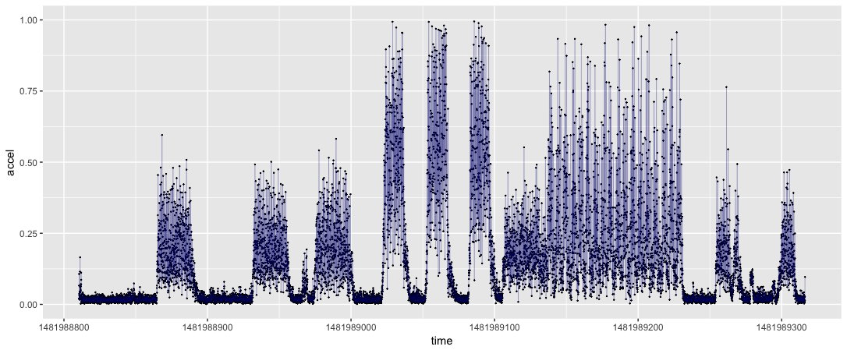
Transformation: Net acceleration
Motivation

Slide 30
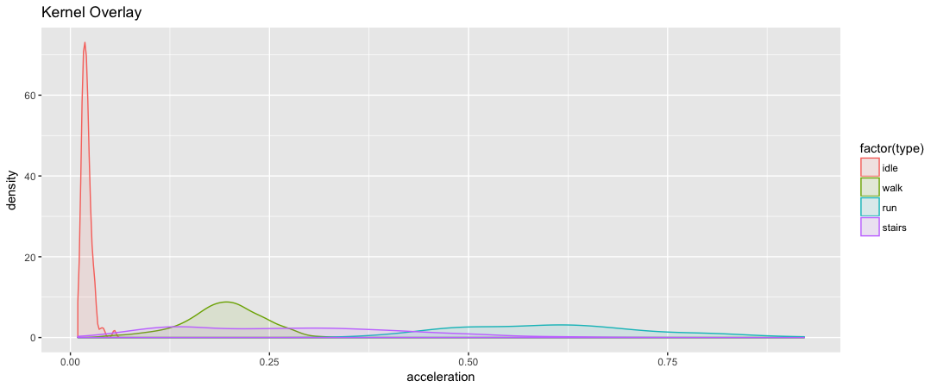
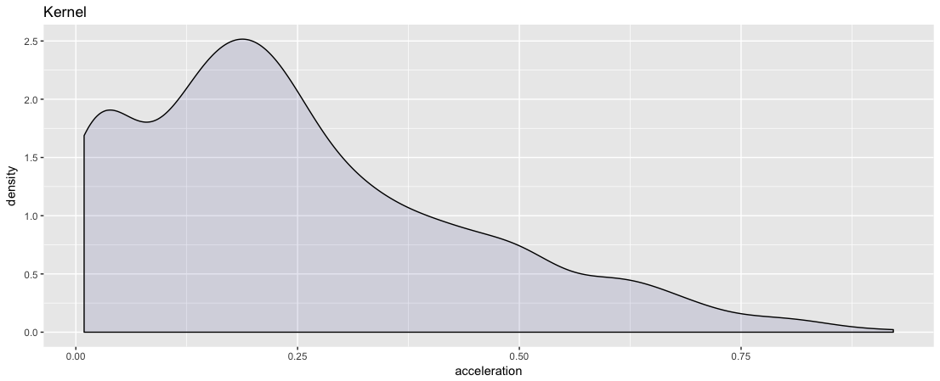
Distribution
Motivation
Notes:
Together, the histogram is not useful

Slide 31
Distribution
Motivation
Notes:
Broken out by subarea – still not helpful

Slide 32
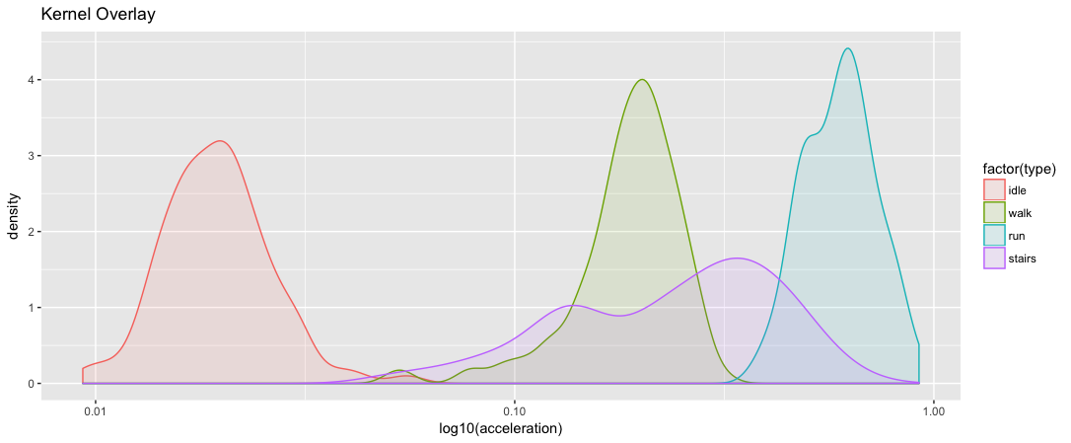
Distribution: Kernel Density
Motivation
Notes:
The shape matters --

Slide 33
2 – Data Quality
Goal | Common Questions
Detect outliers, missingness and errors | Are there anomalous values? Do records spike or occur during odd times? How complete is the data? Which variables need to be standardized and cleaned?
#How JC approaches a time series: Goal – distill signal
##check structure for NAs
##If NA’s less than 10%
#### Impute records
##If continuous
####Graph data as line graph and kernel density
####If noisy
######smooth records, downsample or conduct extraction of features
Motivation

Slide 34
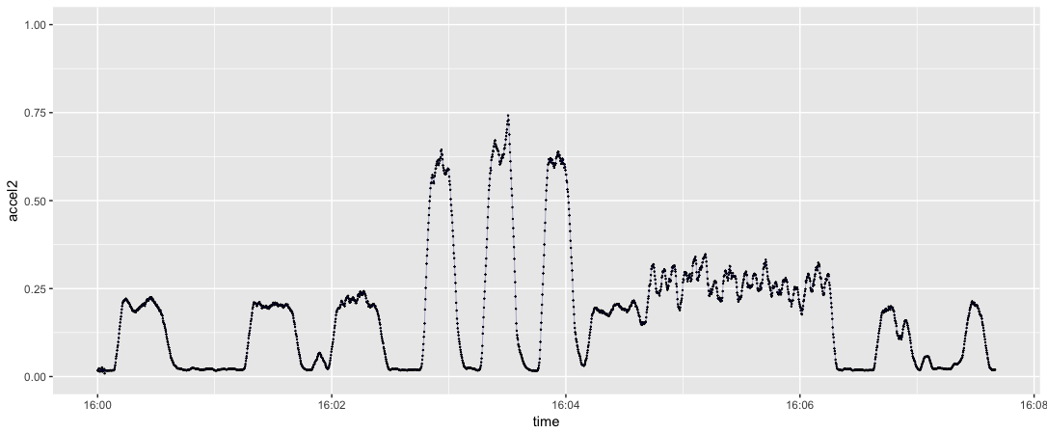
Transformation: Smoothed (1 hertz)
Motivation
Notes:
Why smooth?

Slide 35
Transformation: Local min/max/mean extracted
Motivation
Notes:
A common feature extraction technique is to calculate the local summary statistics for each point
In this case, it’s the last 20 points

Slide 36
Comparison with Labels: Smoothed (1 hertz)
Motivation
Notes:
Why smooth?

Slide 37
Follow-Up: Assumptions
Goal | Common Questions
Check the assumptions | How exactly is the data collected? Does the data reflect what would be expected?
Qualitative – discussion and review documents
If possible,
Replicate data collection to quantify tolerances
Motivation

Slide 38
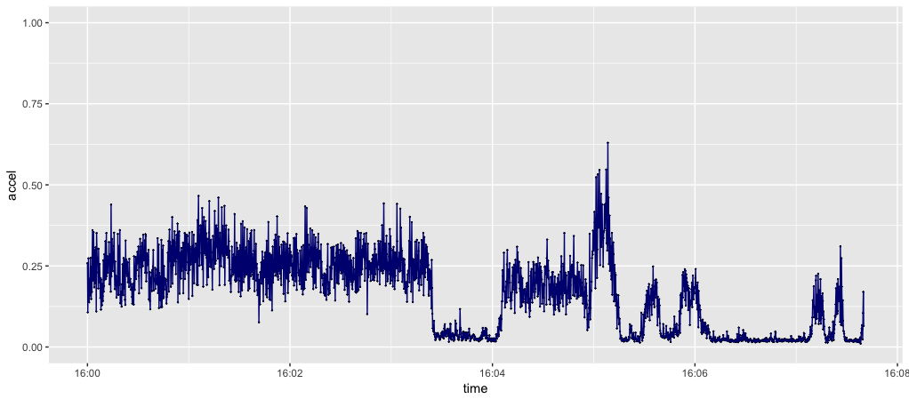
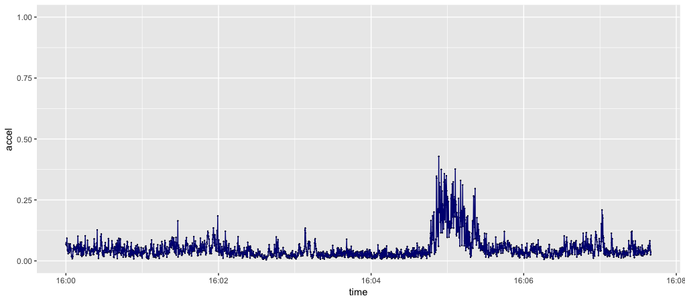
Plane landing
Motivation

Slide 39
Walk around a city
Motivation

Slide 40
Roadmap
Homework Review
EDA
Code-along
Intro to Data Science for Public Policy

Slide 41
For next time
Review next set of lecture notes
Codealong

